Slide 1
Cause-and-Effect to Empower Drug Discovery in a Generative AI World
April 17th, 2024
PISTOIA ALLIANCE LONDON, UK

Slide 2
Doing R&D earlier in discovery enables us to fail fast & prioritise the right drugs
Right target?
Strong link between target and disease
Differentiated efficacy
Available and predictive biomarkers
Right tissue?
Indication
Right safety?
Adequate bioavailability and tissue exposure
Definition of PD biomarkers
Clear understanding of preclinical and clinical PK/PD
Understanding of drug-drug interactions
Right patient?
Right commercial potential?
2
Source: Morgan et al (2018) Nature

Slide 3
Published research & other text is packed full of knowledge yet remains largely uncurated.
100M Articles
Hard to capture context
Data must be manually curated
Ambiguous Names
Disconnected Research
80% of healthcare data is inaccessible to analysis
Concept Relationships
Novel Data
Every 9-years scientific output doubles
Sources: Database: The Journal of Biological Databases and Curation 2016; Nature 2014

Slide 4
Biorelate have built a platform, Galactic AI™, to capture highly valuable data from text that search engines can’t find
How Galactic AI™ works to augment and empower drug discovery
UNLOCKED TEXT INPUT
ADDED GALACTIC AI™
INTEGRATED DATA
ACCESS THE DATA
Sources inc. journals,
patents, clinical trials
Fully cloud-integrated. 6-hour run-time
6B concept annotations
Galactic Web
For research scientists
Specialized deep learning named entity recognition software, using 40+ ontologies
59M cause-and-effect relationships
Updated daily
Galactic Data
For data scientists
Can process in-house content
Highly accurate relationship extraction, up to 95% precision
2B contextual properties
Galactic API
For Bioinformaticians
40M docs
All key IP is proprietary Biorelate software.
And more with
licensed/proprietary docs
All products and services are powered by Galactic AI™
Source: Biorelate

Slide 5
How can cause-and-effect help us better understand potential targets
5

Slide 6
For cause-and-effect in systems biology we look for changes in abundance or activity
“IFI6 augmented HSF1 activity...”
1. Each entity is correctly normalised to its ID (e.g. HGNC ID)
IFI6
HSF1
2. Relationship & directionality is correctly assigned to the relationship
IFI6
HSF1
3. Relationship type & state change captured
IFI6
increases
HSF1
augments
Source: Biorelate

Slide 7
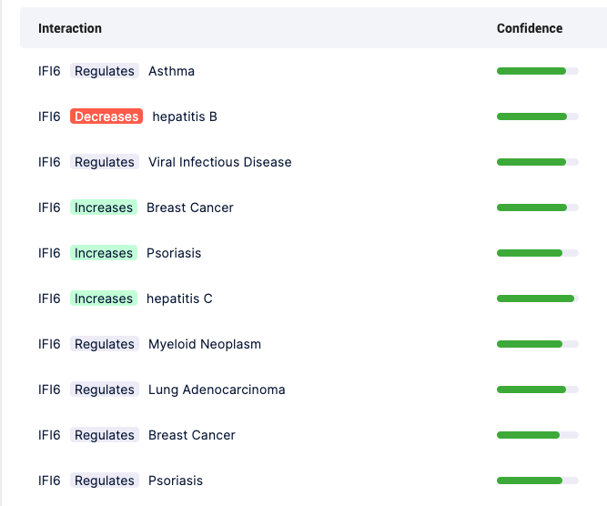
Cause-and-effect can be used to find direct links between targets and diseases
7
Source: Galactic Web

Slide 8
Cause-and-effect relationships can be connected to help build hypotheses
IFI6
“IFI6 augmented HSF1 activity...”
Jia et al, 2020, JDS
By capturing and connecting knowledge together we can infer new meaning and insights.
HSF1
“...HSF1-mediated upregulation of LDH-A.”
Zhao et al, 2009, Oncogene
LDHA
“...LDH-A silencing suppresses breast cancer tumorigenicity.”
Breast Cancer
Sun et al, 2014, PLoS One
8
Source: Galactic AI™

Slide 9
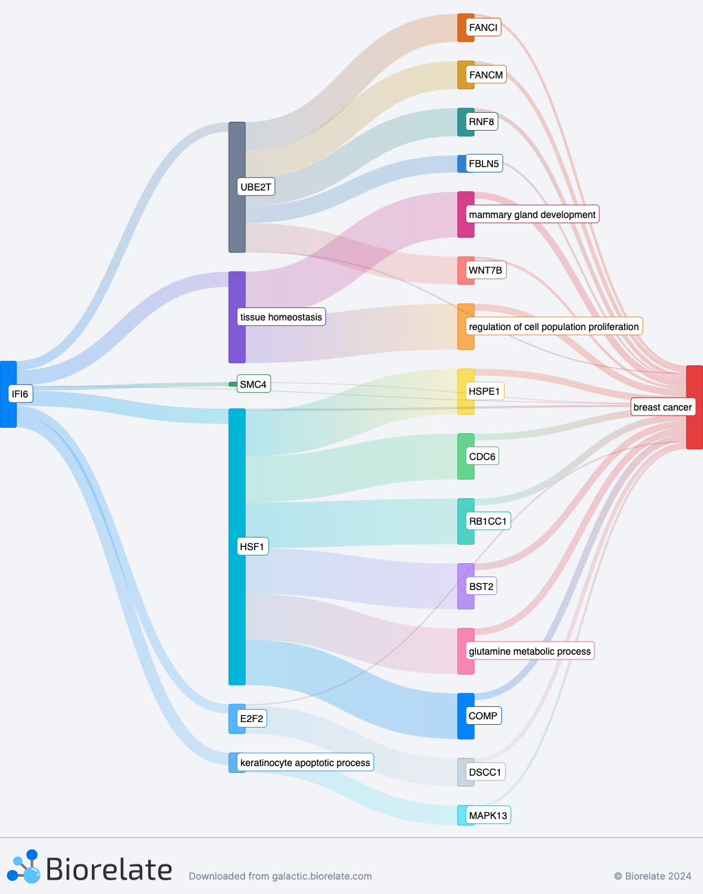
Connecting and ranking cause-and-effect paths gives us a better understanding of all the links together
IFI6-HSF1-LDHA-breast cancer is one path of many
Paths ranked by specificity reducing study bias
Overall significance of target-disease link can be measured across all paths.
9
Source: Biorelate Galactic Web

Slide 10
Generative AI can help summarise the evidence
“IFI6 appears to have a complex role in the modulation of breast cancer, with evidence suggesting both tumor-promoting and tumor-suppressing effects. High confidence paths indicate that IFI6 increases breast cancer risk, potentially by augmenting the activity of HSF1, which is implicated in breast cancer etiology and may regulate various processes including mitochondrial ROS production and glutamine metabolism. Additionally, IFI6 may influence breast cancer progression through the regulation of tissue homeostasis and mammary gland development. However, IFI6 is also reported to decrease the expression of UBE2T, which in turn has been associated with the inhibition of tumor growth by suppressing WNT7B. Moreover, IFI6's effect on breast cancer through the regulation of UBE2T seems to be involved in a complex network of downstream targets like FANCI, FANCM, RNF8, and FBLN5, which have roles in DNA repair, apoptosis, and cell proliferation, further complicating the understanding of IFI6's overall impact on breast cancer.”
Summary from generative AI on Galactic Web
Uses evidence behind each link to generate an overall summary
10
Source: Biorelate Galactic Web

Slide 11
Systematically discovering novel target-disease links through cause-and-effect
11

Slide 12
There are 721M possible single protein to disease pairs
19K
Human protein
coding genes
18K
Human
diseases
20K
Human
phenotypes
721M
Possible human single protein coding gene
to disease or phenotype pairs*
*NB, there are many other possible combinations (e.g., miRNAs, chemicals, complexes etc.)
12
Source: Biorelate

Slide 13
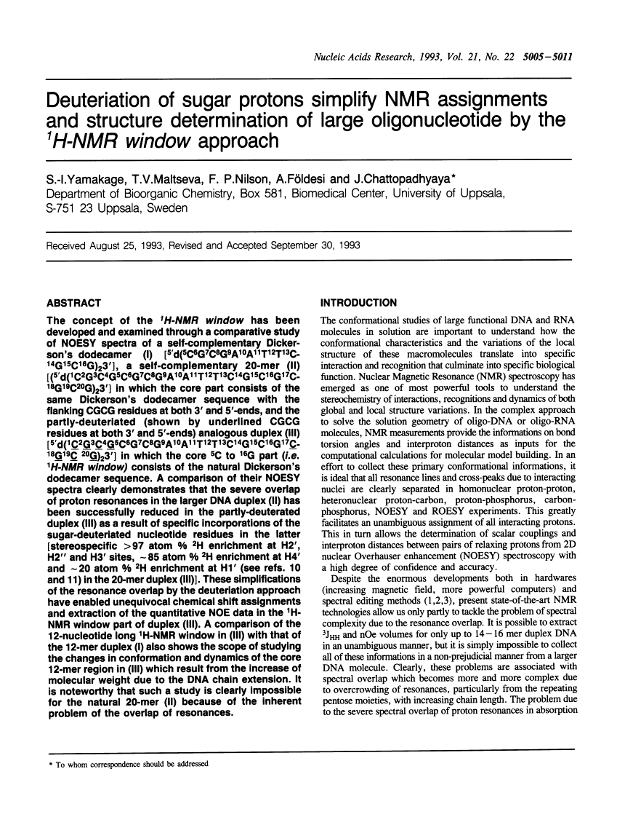
Only 5% of all protein–disease pairs have ever been published together*
including IFIT1, ISG15, IFI6, GOLM5, KLHL35, and OAS2, were associated with the total survival probability in breast cancer patients
IFI6 may promote breast cancer metastasis
35M
Document Co-Mentions
5.2M
Sentence Co-Mentions
714K Cause-and-effect
*Includes all open access literature, pre-prints, grants, drug labels, clinical trials & patents. Excludes closed-access full text.
13
Source: Galactic AI™

Slide 14
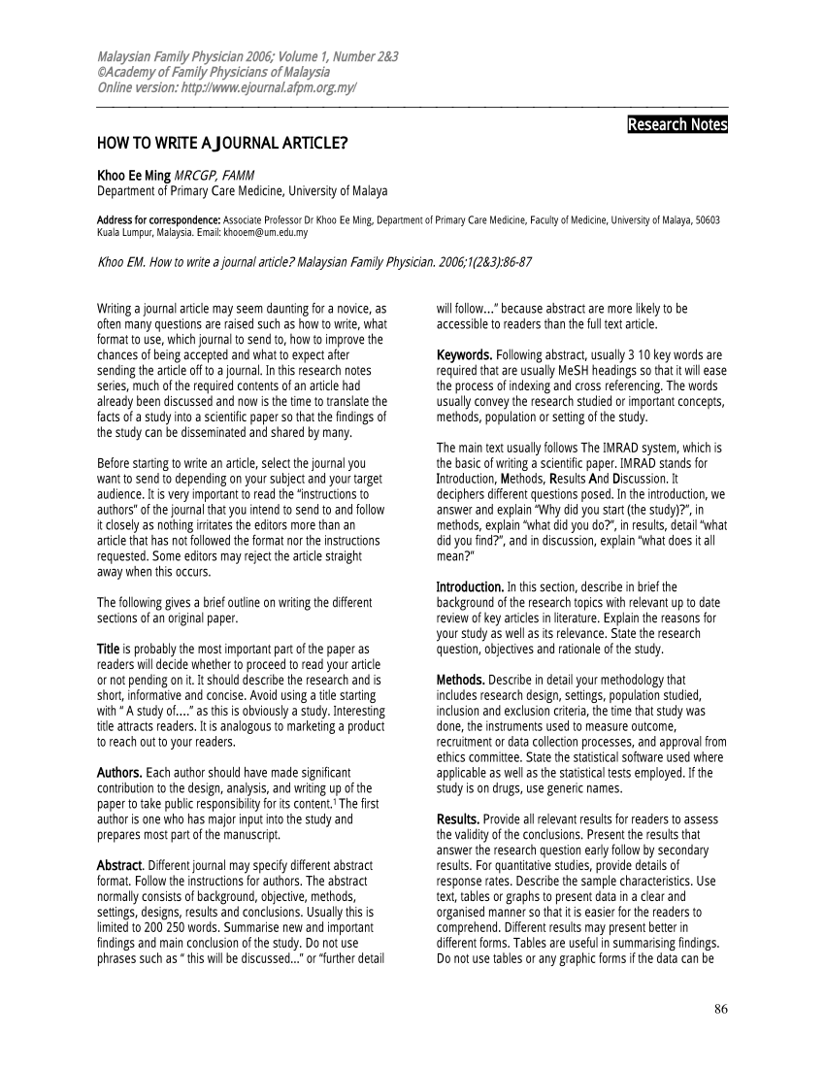
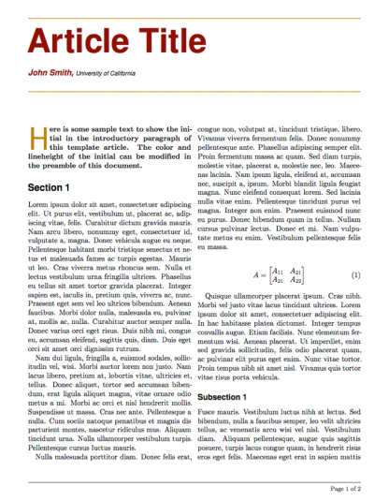
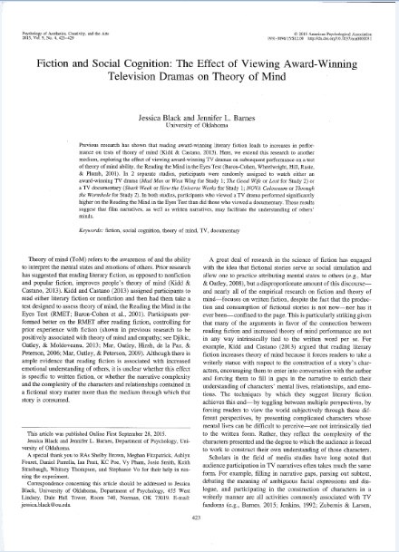
Connecting cause-and-effect relationships greatly increases target-disease links
714K
NOVEL
NOVEL
A
B
B
C
C
D
714K
Depth 1
12M Depth 2
89M
Depth 3
Reminder: at depth 1, links are known, but at depths 2 and 3 the targets and diseases are novel and have not been mentioned together
14
Source: Biorelate

Slide 15
There are 89M novel target-disease links to explore, many are significant
Target name | Disease name | Connecting nodes depth 2 | Connecting nodes depth 3 | Document comentions | Enrichment p value
RBMS1 | Cardiomyocyte hypertrophy | 72 | 783 | 0 | <0.05
LGALS9 | Cardiomyocyte hypertrophy | 70 | 777 | 0
PDLIM7 | Allodynia | 70 | 698 | 0
MEN1 | Vascular calcification | 67 | 510 | 0
PDLIM7 | Retinal neovascularization | 67 | 297 | 0
CYLD | Vascular calcification | 64 | 510 | 0
FNDC5 | stomach carcinoma | 64 | 411 | 0
PDLIM7 | Renal interstitial fibrosis | 64 | 262 | 0
SATB1 | renal fibrosis | 63 | 1075 | 0
NFAT5 | retinal degeneration | 60 | 481 | 0
CONFIDENTIAL
15
Source: Galactic AI™

Slide 16
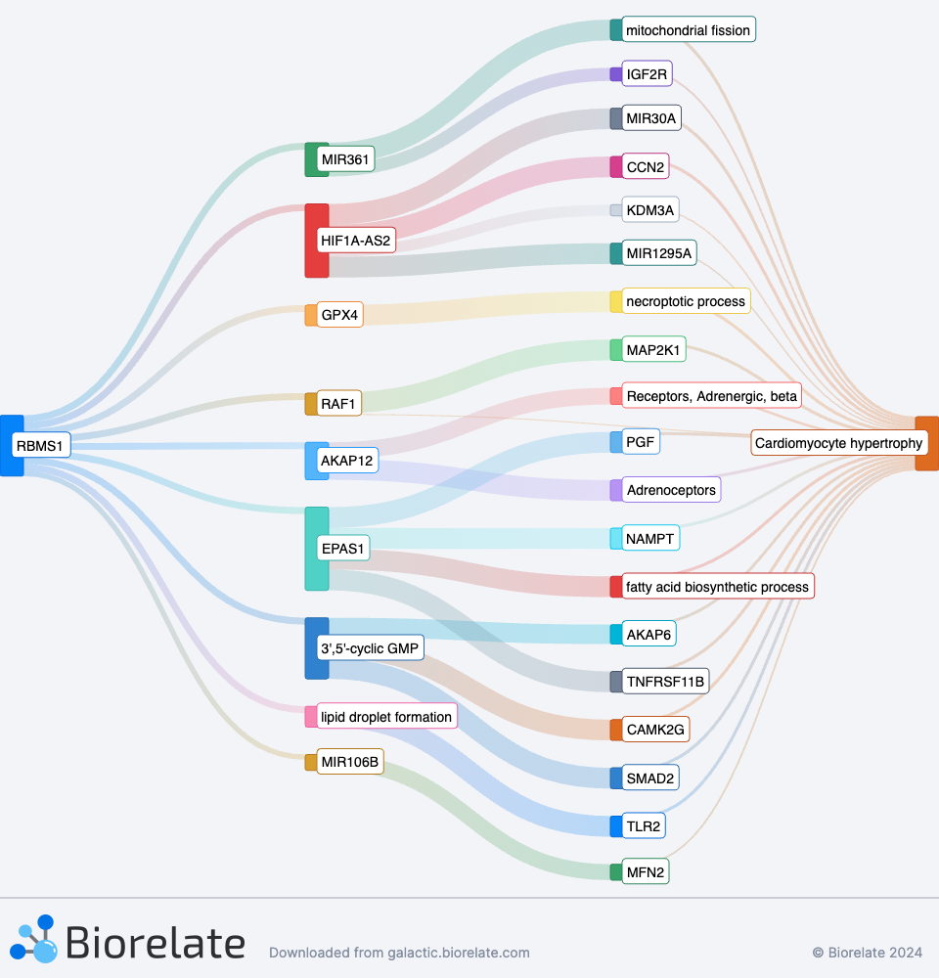
RBMS1 appears to be a promising entirely novel target for CH
“RBMS1 appears to be a regulatory protein involved in cardiomyocyte hypertrophy through multiple pathways, with varying effects. It can decrease the expression of HIF1A-AS2, which in turn regulates other molecules such as CCN2 and KDM3A that increase cardiomyocyte hypertrophy. RBMS1 also influences the levels of MIR361 and MIR30A, leading to changes in mitochondrial fission and the necroptotic process, which affect cardiomyocyte hypertrophy. Furthermore, RBMS1 can increase RAF1, a protein known to induce hypertrophy, as well as modulate 3',5'-cyclic GMP levels which regulate AKAP6 and CAMK2G, both implicated in hypertrophic processes. Finally, evidence suggests that RBMS1 decreases EPAS1, which increases factors like PGF, NAMPT, and fatty acid biosynthetic processes, all contributing to cardiomyocyte hypertrophy.”
16
Source: Galactic Web

Slide 17
Summary
01
Drug discovery is expensive & at a macro scale failing fast matters
02
Biorelate mine complex data, like cause-and-effect, to empower truth seeking behaviours
03
Analysing cause-and-effect-like data can add depth to our understanding of targets
04
Generative AI works well as to interface with data, overcoming hallucinations
05
Entirely novel target hypotheses can be derived systematically to turbo-charge target ID
17

Slide 18
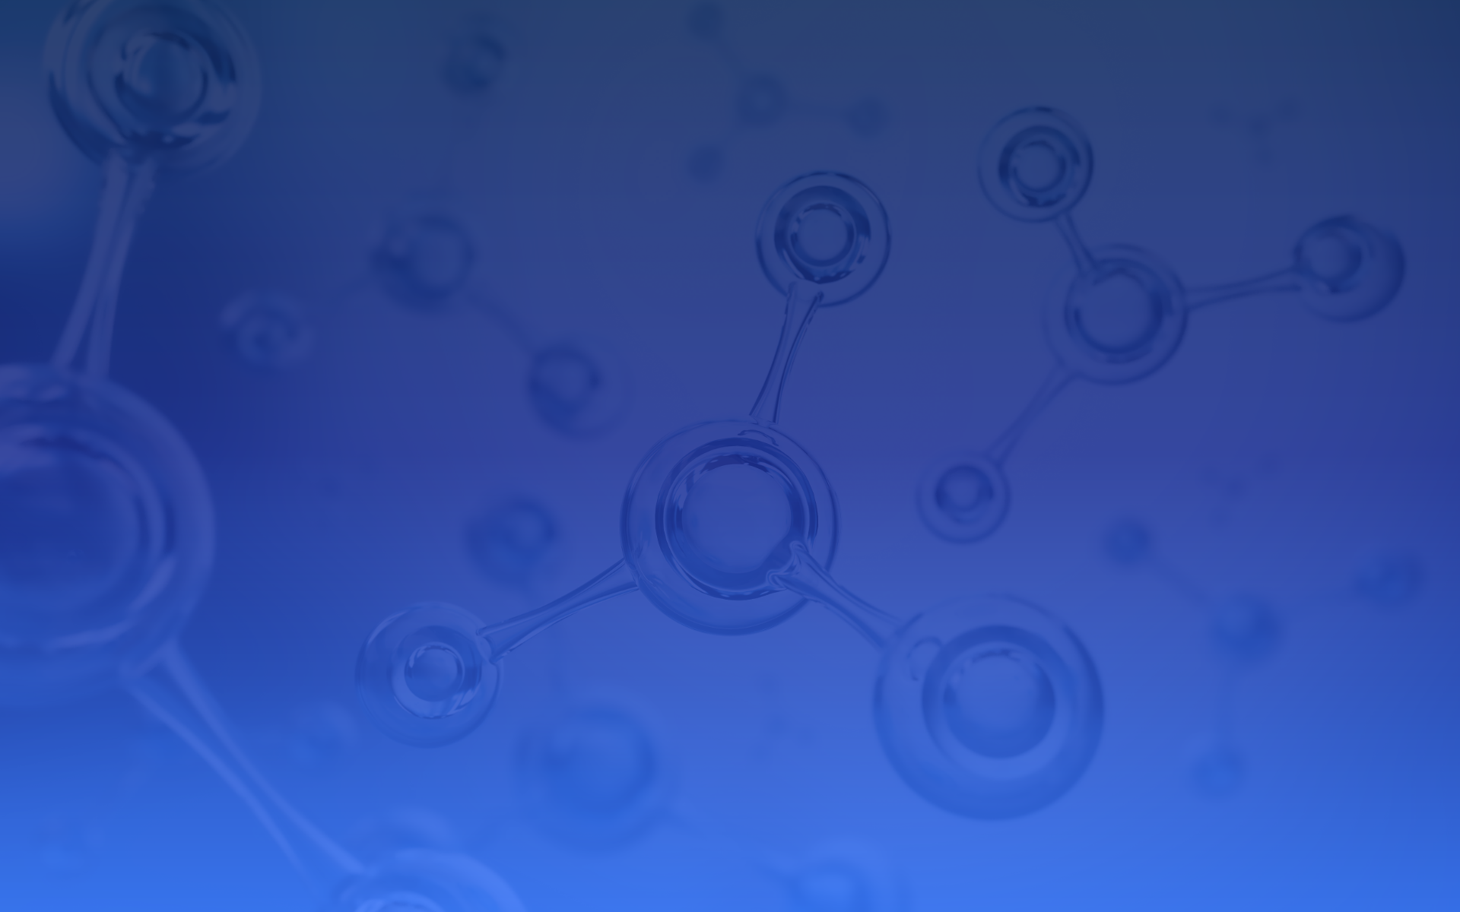
Questions

Slide 19
What are the most promising up-and-coming targets in clinical studies and research for oncology?
19
Source: https://forms.app/en/blog/research-memes

Slide 20
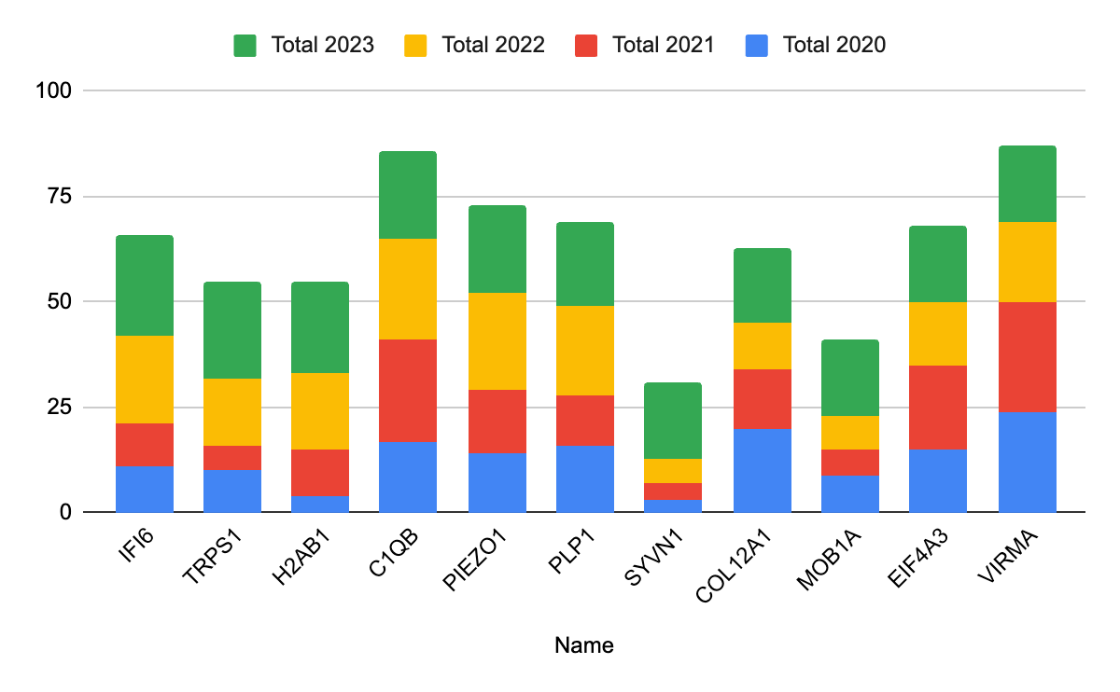
Proteins yet to feature in oncology clinical trials, that are emerging in research
Shows proteins that have a low rate of publications prior to last two years
Each protein has not been mentioned in clinical oncology research before
These are interesting in that they are potentially future new targets in clinical trials
20
Source: Galactic AI™

Slide 21
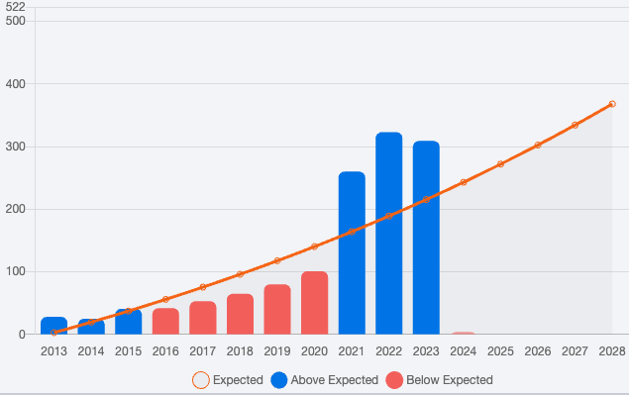
IFI6 interest is growing within the oncology research community
Shows some of the recent relevant oncology articles mentioning IFI6
However, on its own it’s not too useful for investigating causal biology
21
Source: Galactic Web

Slide 22
Using cause-and-effect to discover novel target-disease links
22

Slide 23
Differentiating knowns from unknowns with targets and diseases
Cause-and-Effect
Sentence Co-Mention
Document Co-Mention
No Co-Mentions
including IFIT1, ISG15, IFI6, GOLM5, KLHL35, and OAS2, were associated with the total survival probability in breast cancer patients
IFI6 may promote breast cancer metastasis
NOVEL
Decreasing strength of knowledge
If a target and disease aren’t mentioned together in any papers they can be considered a potential novel link
23
Source: Biorelate

Slide 24
However, connecting cause-and-effect relationships can expose novelty
NOVEL
NOVEL
A
B
B
C
C
D
Depth 1
Depth 2
Depth 3
24
Source: Biorelate

Slide 25
Novel Targets for Breast Cancer (BC)
Target Name | Connecting nodes depth 2 | Connecting nodes depth 3 | Document comentions | Enrichment p value
TRIM64 | 11 | 2041 | 0 | <0.05
ADISSP | 9 | 2615 | 0
SPATA33 | 5 | 2076 | 0
DEFB131A | 5 | 2028 | 0
ZNF852 | 4 | 585 | 0
ZNF684 | 4 | 219 | 0
OR7A17 | 3 | 637 | 0
FANCD2OS | 3 | 523 | 0
HIGD1C | 3 | 446 | 0
DEFB123 | 2 | 1864 | 0
Shows one of the top novel targets for breast cancer
Despite a high number of connecting nodes at both depth 2 and depth 3 it has not appeared in a publication with BC before
Enrichment (significance) can be measured using the hypergeometric mean
CONFIDENTIAL
25
Source: Galactic AI™

Slide 26
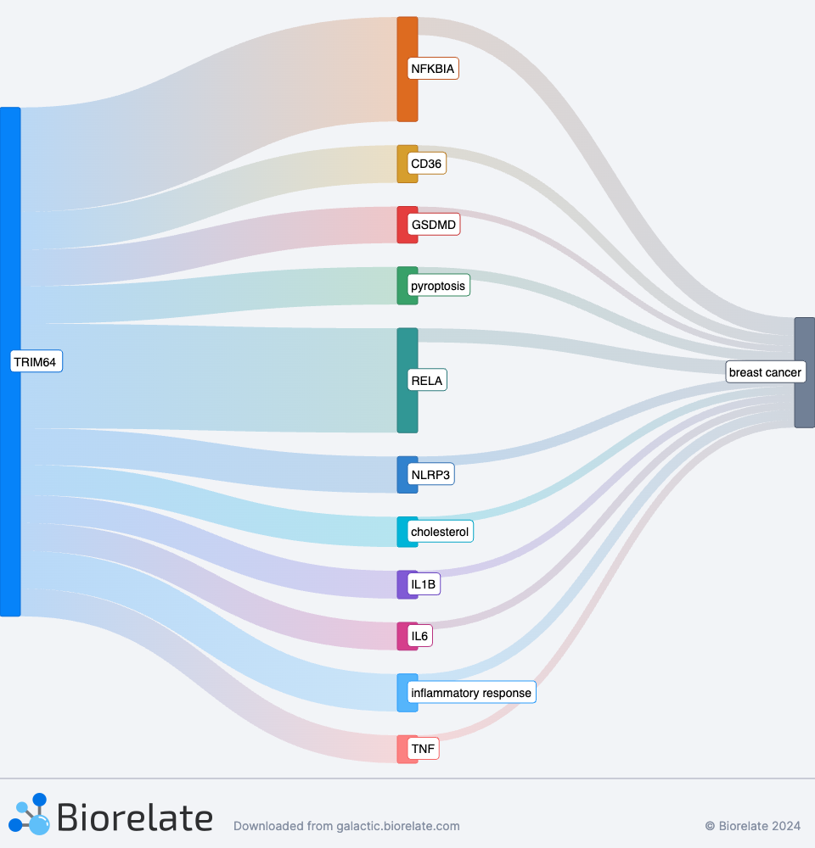
Generative AI can again do the heavy lifting to explain the mechanistic rationale
TRIM64 appears to have a complex role in breast cancer, with evidence suggesting it can both contribute to and protect against the disease. On one hand, TRIM64 overexpression is associated with increased lipid accumulation, cholesterol content, scavenger receptor CD36 activity, cell pyroptosis, and activation of inflammatory pathways involving ASC, pro-caspase-1, NLRP3, GSDMD-N, and active caspase-1, all of which can promote breast cancer progression. Inflammatory markers such as NF-κB p65, TNF-α, and IL-6 are also overexpressed in mammary tumor tissues, and the activation of these pathways is known to contribute to breast cancer development. Conversely, NFKBIA, which is increased by TRIM64, plays a protective role against breast cancer. Overall, while TRIM64 has been implicated in pro-cancerous processes such as cholesterol promotion, pyroptosis, and inflammation, there is also evidence of its involvement in anti-cancerous activities, indicating a need for further research to fully understand its dualistic role in breast cancer.
26
Source: Galactic Web

Slide 27
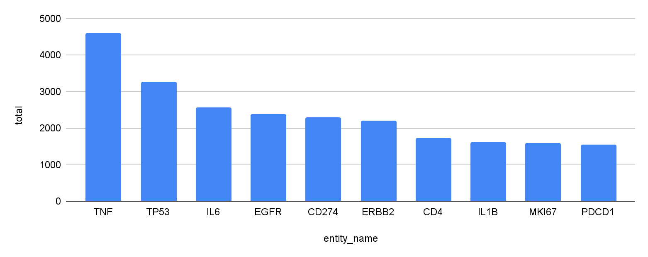
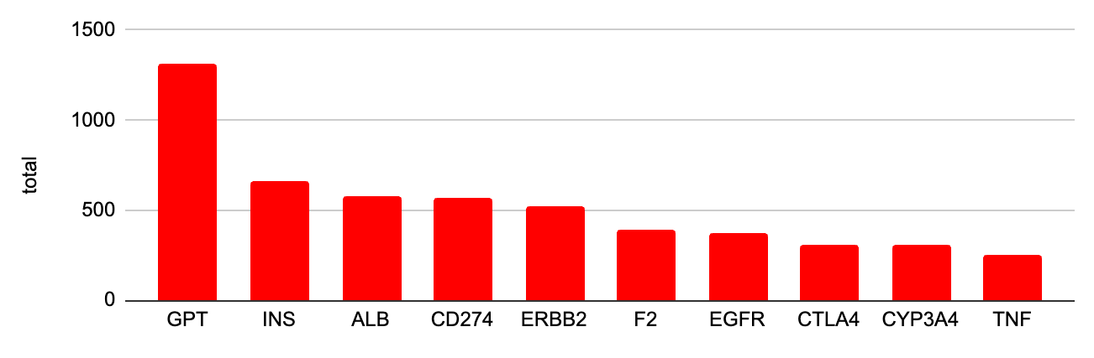
Most commonly mentioned proteins in oncology in 2023
Oncology Research Articles
Shows the number of articles by protein, split between research and oncology
Unsurprisingly, doesn’t show us anything that interesting
Oncology Clinical Articles
27
Source: Galactic AI™

Slide 28
Challenge: Costs $2 billion to get a drug to market. Relies on informed decision making at every stage
LEAD OPTIMIZATION
DISCOVERY
PRE-CLINICAL
PHASE 1
PHASE 2
PHASE 3
REGISTRATION
$353M
$562M
$340M
$63M
$119M
$344M
$3M
2.5 YRS
2 YRS
1 YR
1.5 YRS
2.5 YRS
2.5 YRS
1.5 YRS
10,000 candidates
250
candidates
10-20
candidates
6
candidates
2
candidates
1
candidate
Prioritising the right drugs to move forward or failing fast in clinical trials means everything for return on investment.
To prioritise well, it involves accurately understanding how drugs work, based on the latest data.
However, 80% of healthcare data is locked in text, hindering informed decisions.
Sources: Sun et al, 2022; https://ftloscience.com/process-costs-drug-development/

Slide 29
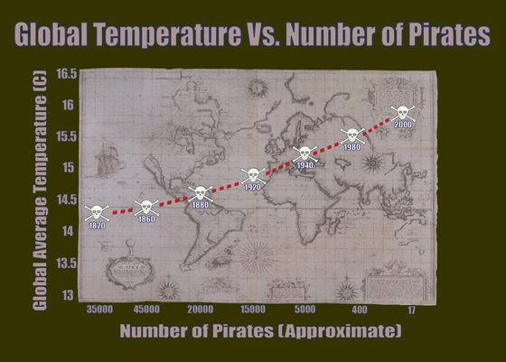
When something is causal vs correlative
Correlation is any statistical relationship, however it does not imply causation.
Causes can be proximate (closest to) and ultimate (real reason)
Cause-and-effect is directional, where causes must occur in the past.
Causes usually have rational explanations
Source: Biorelate;
https://medium.com/swlh/a-visualization-correlation-vs-causation-d86d02b1042c

Slide 30
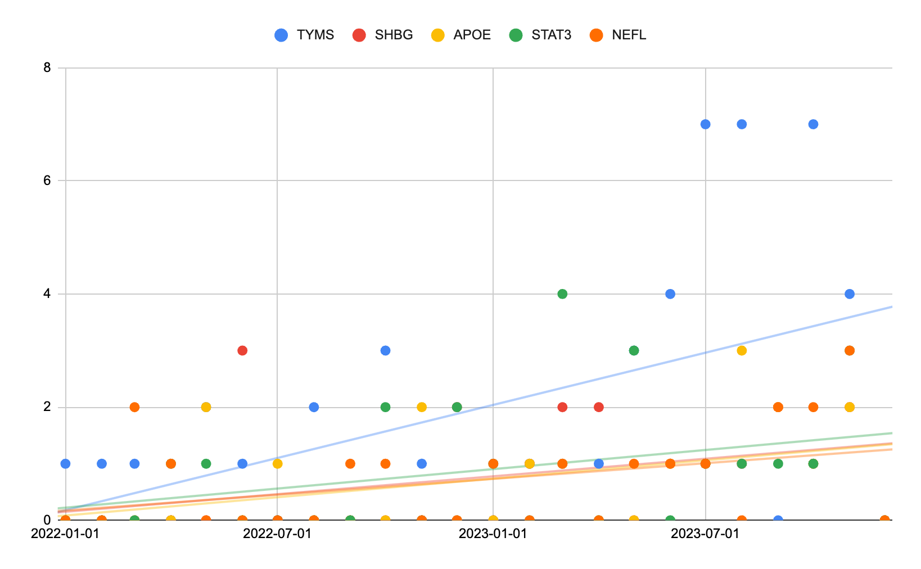
Proteins “trending” in clinical oncology research over the last 2 years
Shows proteins that have had the sharpest increase in clinical oncology papers over last two years
Linear regression used to measure slope of curve, corrected against background literature growth
Proteins are more interesting, but still fairly well known
30
Source: Galactic AI™

Slide 31
Synergizing with Generative AI
Galactic AI™ curates unstructured data using fine-tuned models and then acts as the knowledge-anchor for generative AI.
Unstructured text
NLP
Structured Data
AI & Interfaces
Decision Intelligence
Internal Dashboards
External Text
Other Sources of Knowledge
User Questions
Galactic AI™
Galactic Web
In-house Text
Galactic Data
Alerts & Insights
Galactic API
GENERATIVE AI
80% of healthcare data inaccessible for analysis
Galactic AI™ is a state-of-the-art NLP platform. Fine-tuned LLMs are integrated solely for data-curation
Structured data can be combined with other sources of knowledge to gain 100% coverage
Generative AI uses structured data within interfaces
Users can make better decisions grounded in traceable data

